Slide 1
SEISMIC-GEODYNAMIC MODELS OF SUBDUCTION

Slide 2
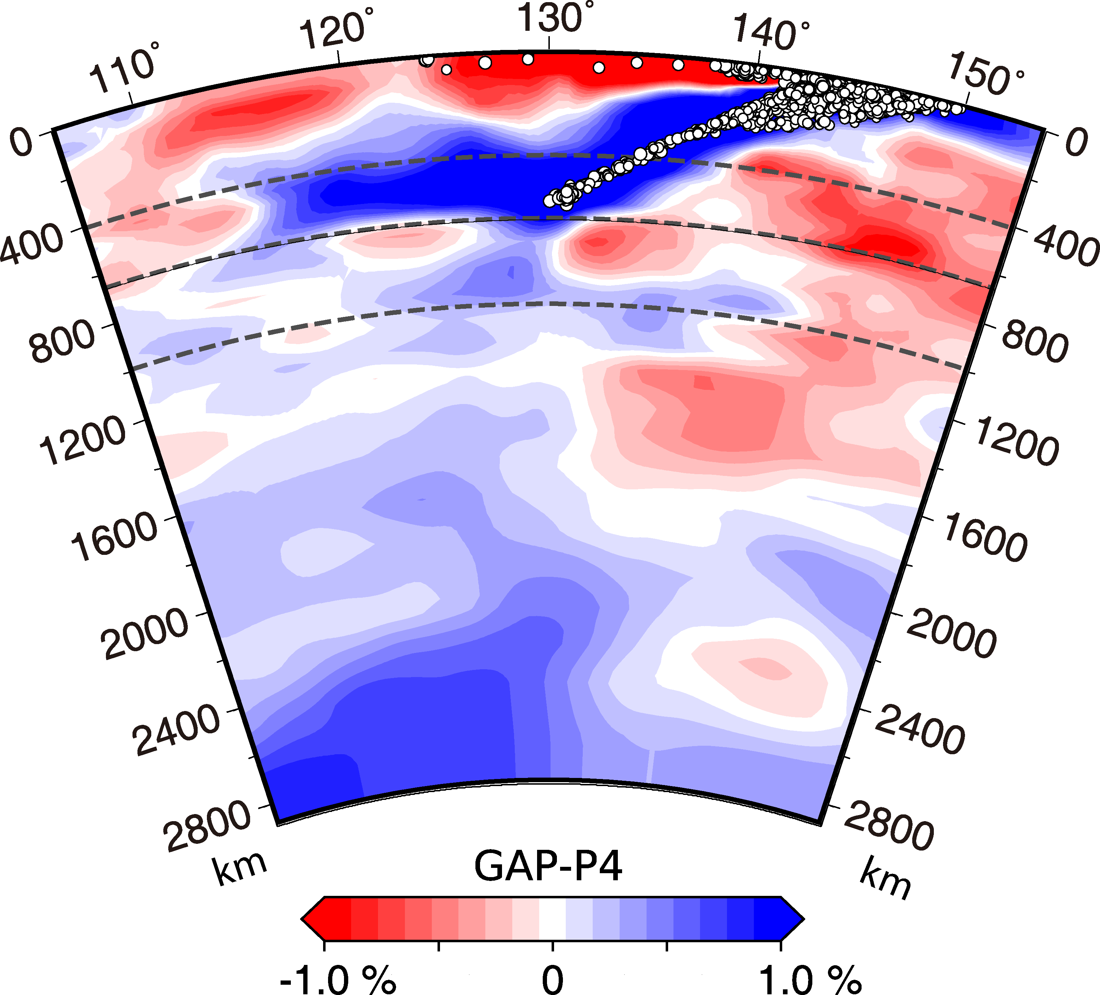

SEISMIC-GEODYNAMIC MODELS OF SUBDUCTION
Fukao and Obayashi (2013)

Slide 3
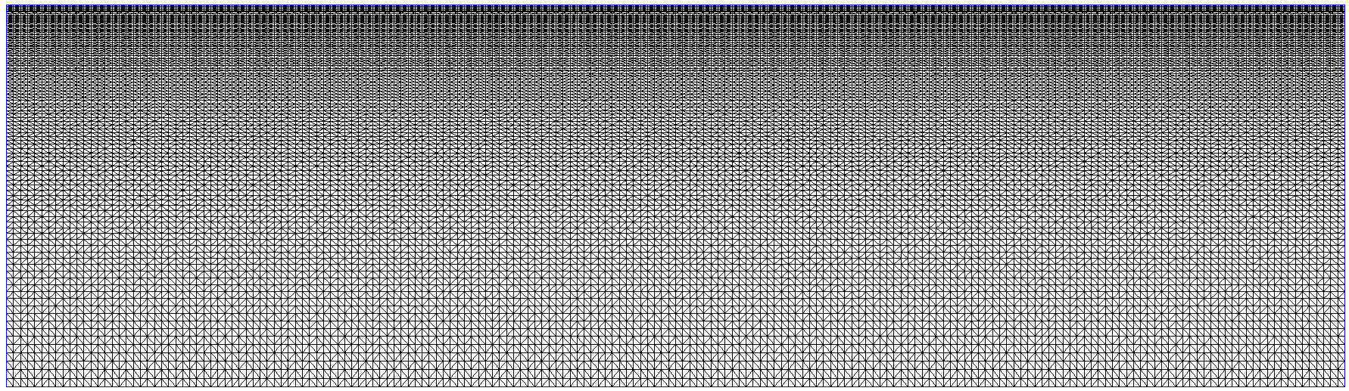
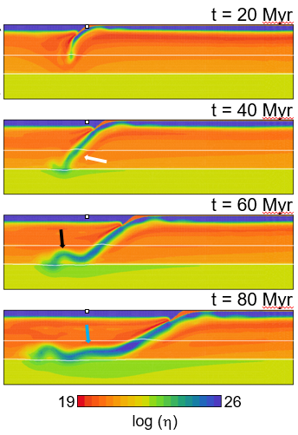
SEISMIC-GEODYNAMIC MODELS OF SUBDUCTION
Fukao and Obayashi (2013)
Euro-Asian plate Pacific plate
2000 km
η = η (T,p,σ)

Slide 4
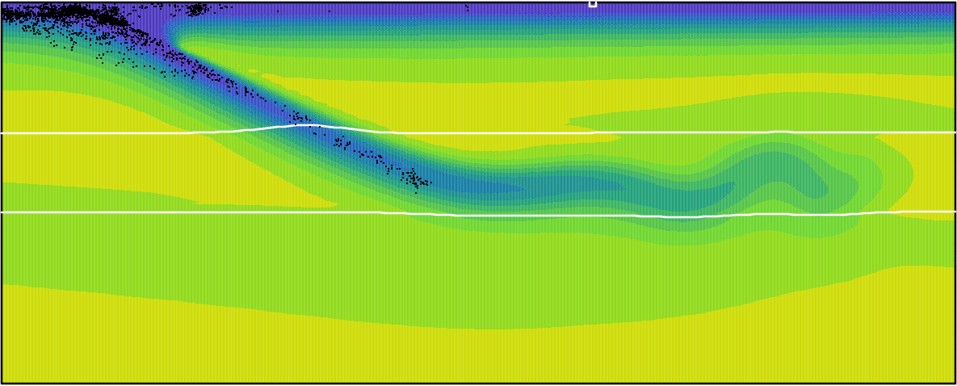
SEISMIC-GEODYNAMIC MODELS OF SUBDUCTION
Fukao and Obayashi (2013)
Euro-Asian plate Pacific plate
2000 km
η = η (T,p,σ)
-1000 0
ΔT (K)

Slide 5
SEISMIC-GEODYNAMIC MODELS OF SUBDUCTION
Fukao and Obayashi (2013)
Euro-Asian plate Pacific plate
2000 km
η = η (T,p,σ)
Stress distribution from seismicity
1. generation models that fit locations, stress orientations, …
-1000 0
ΔT (K)

Slide 6
SLABS IN THE UPPER MANTLE AND TRANSITION ZONE
Complex deformation due to
Mineralogy – phase transitions, dehydration
Rheology – nonlinear deformation mechanisms, role of water, increase of viscosity in the lower mantle, presumably change of deformation mechanism …

Slide 7
SLABS IN THE UPPER MANTLE AND TRANSITION ZONE
Slab dynamics at the base of the upper mantle is close to threshold – any small change of parameters can decide whether the slab stagnates or penetrates
Rheology of crust that decouples the plates plays an important role
Subduction models often use entrained weak layer with either constant viscosity (e.g. Běhounková and Čížková,2008; Chertova et al., 2012; Holt et al., 2015; Agrusta et sl., 2017) or nonlinear rheology (e.g. Garel et al., 2014; Crameri and Tackley, 2014; Liao et al., 2017)
The magnitude of crustal viscosity was reported to affect plate velocities (Androvičová et al., 2013; Holt et al., 2015) and higher crustal viscosity inhibits rollback (Čížková and Bina, 2013; Arredondo and Billen, 2017; Holt et al., 2015)
The lubrication effect of the weak crustal layer is further affected by its thickness which evolves with time. In constant crustal viscosity models its transient thinning may hamper lubrication especially if the thinned layer is not properly resolved (Sandiford and Moresi, 2019; Pokorný et al., 2021)

Slide 8
EXAMPLE 1: SEISMICITY IN WESTERN PACIFIC

Slide 9
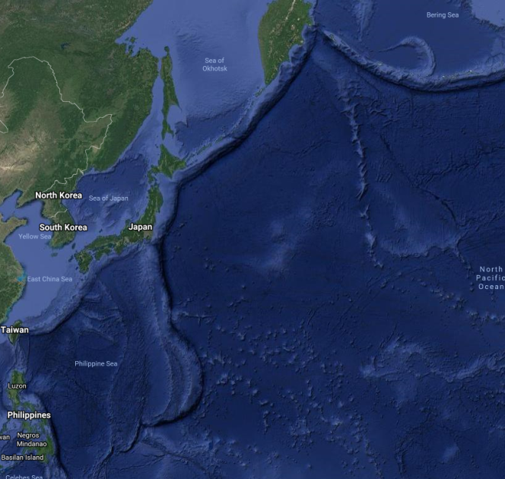
SEISMICITY WESTERN PACIFIC

Slide 10
SEISMICITY WESTERN PACIFIC
Fukao and Obayashi (2013)

Slide 11
SEISMICITY WESTERN PACIFIC
Fukao and Obayashi (2013)
Stagnation above 660 km boundary

Slide 12
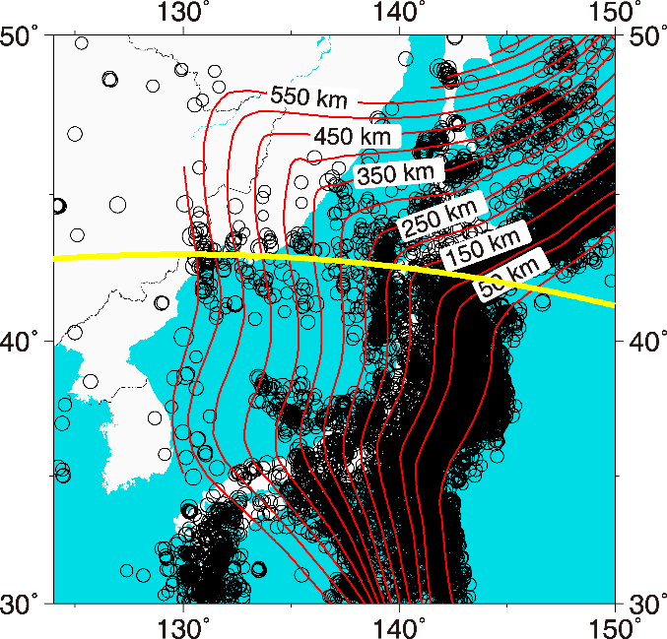
SEISMICITY WESTERN PACIFIC
Fukao and Obayashi (2013)
Stagnation above 660 km boundary

Slide 13
SEISMICITY WESTERN PACIFIC
Fukao and Obayashi (2013)
Stagnation above 660 km boundary
No seismicity in flat-lying part

Slide 14
SEISMICITY WESTERN PACIFIC
Analysis of seismic stresses

Slide 15
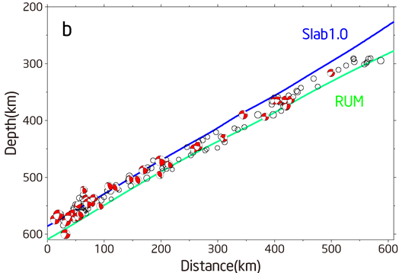
SEISMICITY WESTERN PACIFIC
Analysis of seismic stresses
39 events between 300 and 600 km
Analysis of seismic stresses
39 events between 300 and 600 km, M_{w} 5-6.9

Slide 16
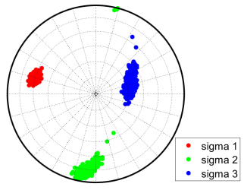
SEISMICITY WESTERN PACIFIC
Analysis of seismic stresses
39 events between 300 and 600 km
Analysis of seismic stresses
39 events between 300 and 600 km, M_{w} 5-6.9
Downdip compression in the dipping part of the slab

Slide 17
SEISMICITY WESTERN PACIFIC
Analysis of seismic stresses
39 events between 300 and 600 km, M_{w} 5-6.9
Downdip compression in the dipping part of the slab
Dip angle ~ 27º

Slide 18
MODEL
Free subduction model of Pacific subduction with ageing plate
3000 km 2000 km
20 Myr old 100 Myr old
EB, nonlinear composite rheology
Major phase transitions
Viscosity increase at 660 km or 1000 km
Weak and buoyant oceanic crust
Initial setup following Yang et al. (2018)
Can we fit dip angle, flat-lying part above 660 km depth, downdip compression? Indication for missing seismicity in flat part?

Slide 19
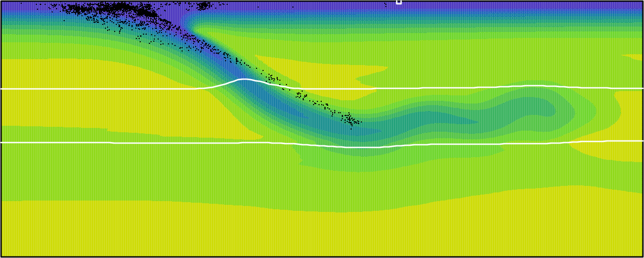
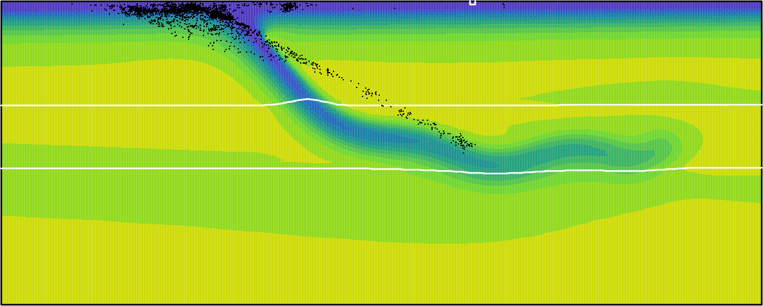
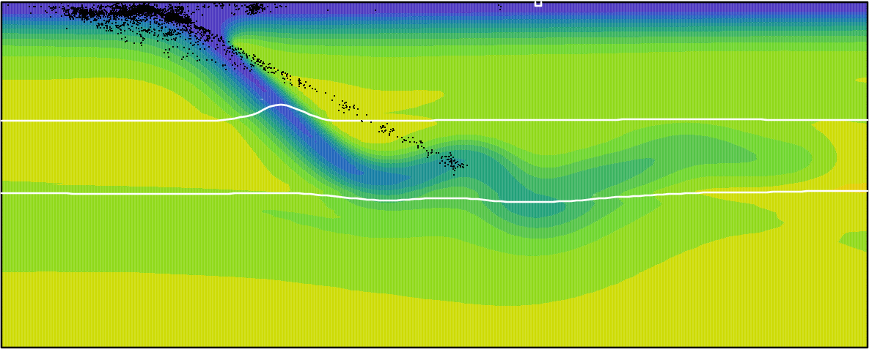
MODEL STRESSES
Free subduction model of Pacific subduction with ageing plate
Δρ_{cr} = -200 kg/m³, weak ph. trans. Δρ_{cr} = -200 kg/m³, strong ph. trans.
M1 83 Myr M2 102 Myr
Δρ_{cr} = 0, weak ph. trans Δρ_{cr} = 0, strong ph. trans.
M3 40 Myr M4 95 Myr
-1000 0
ΔT (K)
Čížková et al., submitted to EPSL

Slide 20
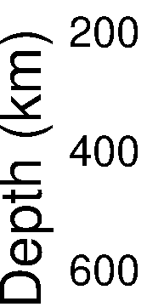
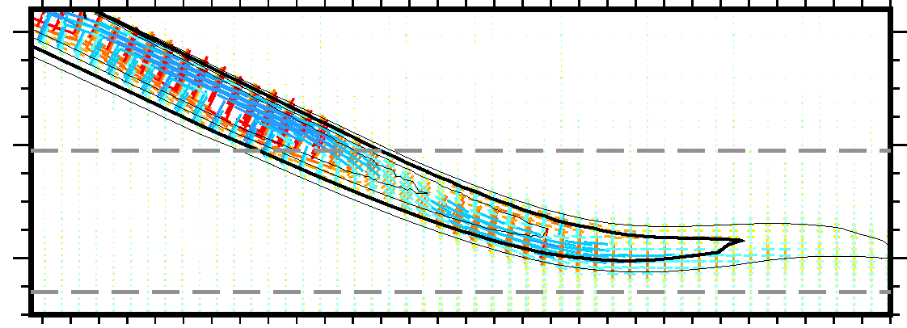
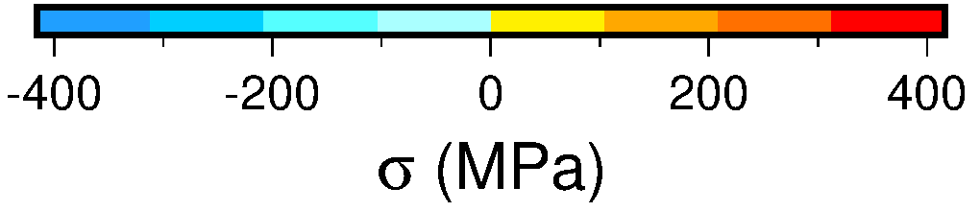
MODEL STRESSES
Free subduction model of Pacific subduction with ageing plate
γ₄₁₀ = 1 MPa/K, γ₆₆₀ = -1.5 MPa/K

Slide 21
MODEL STRESSES
Free subduction model of Pacific subduction with ageing plate
downdip compression
downdip compression
γ₄₁₀ = 1 MPa/K, γ₆₆₀ = -1.5 MPa/K

Slide 22
MODEL STRESSES
Free subduction model of Pacific subduction with ageing plate
downdip compression
downdip extension
downdip extension
downdip compression
γ₄₁₀ = 1 MPa/K, γ₆₆₀ = -1.5 MPa/K

Slide 23
MODEL STRESSES
Free subduction model of Pacific subduction with ageing plate
downdip compression
downdip extension
downdip extension
downdip compression
γ₄₁₀ = 1 MPa/K, γ₆₆₀ = -1.5 MPa/K

Slide 24
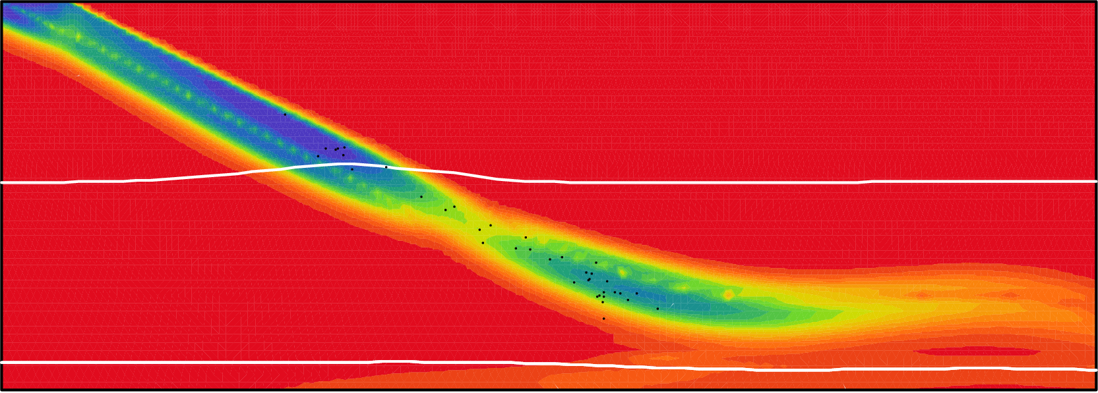
MODEL STRESSES
Free subduction model of Pacific subduction with ageing plate
downdip compression
downdip extension
downdip extension
downdip compression
0 400
σ_{ΙΙ} (MPa)
γ₄₁₀ = 1 MPa/K, γ₆₆₀ = -1.5 MPa/K

Slide 25
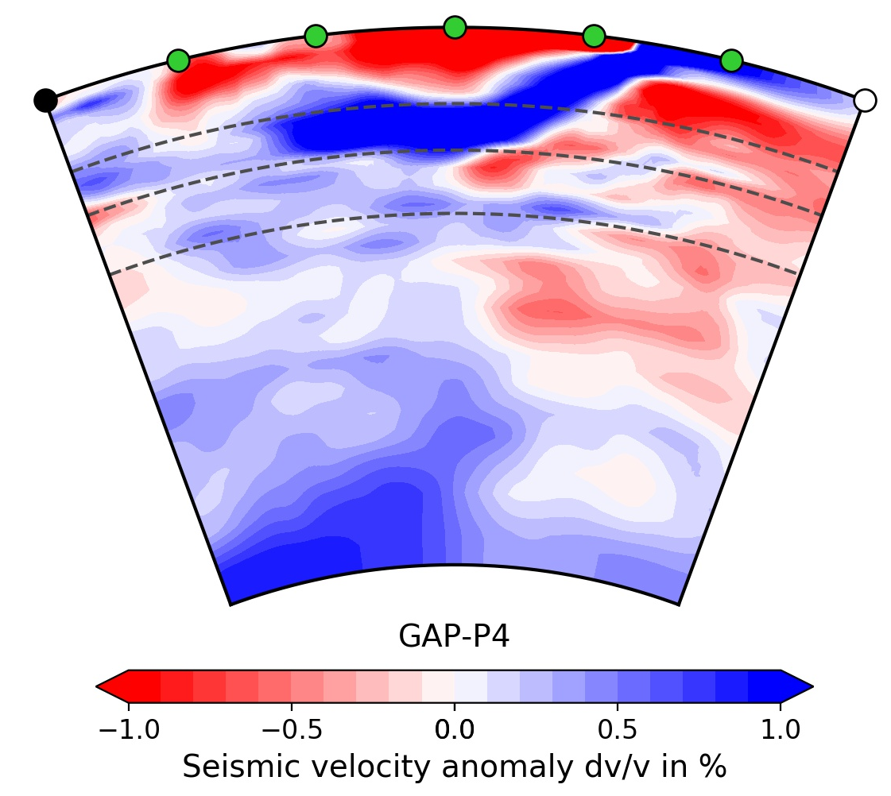
MODEL FIT SEISMICITY
Free subduction model of Pacific subduction with ageing plate
Slab shape in agreement with tomography
Explains seismogenic stress
-1000 0
ΔT (K)
Fukao and Obayashi (2013)
Čížková et al., SciRep 2020

Slide 26
EXAMPLE 2: NAZCA SLAB

Slide 27
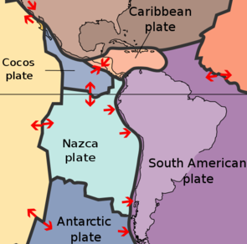
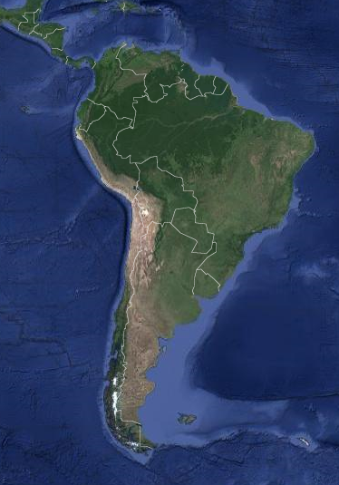
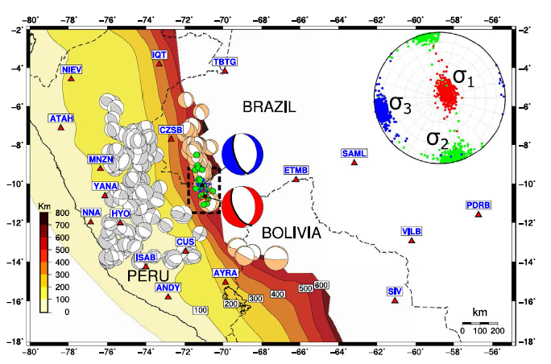
NAZCA SUBDUCTION
Acre, 24.11.2015
earthquake doublet M_{w}~ 7.6
depth ~ 600 km
downdip compression
Zahradník et al. (2017)

Slide 28
NAZCA SUBDUCTION
Acre, 24.11.2015
earthquake doublet M_{w}~ 7.6
depth ~ 600 km
downdip compression
Zahradník et al. (2017)

Slide 29
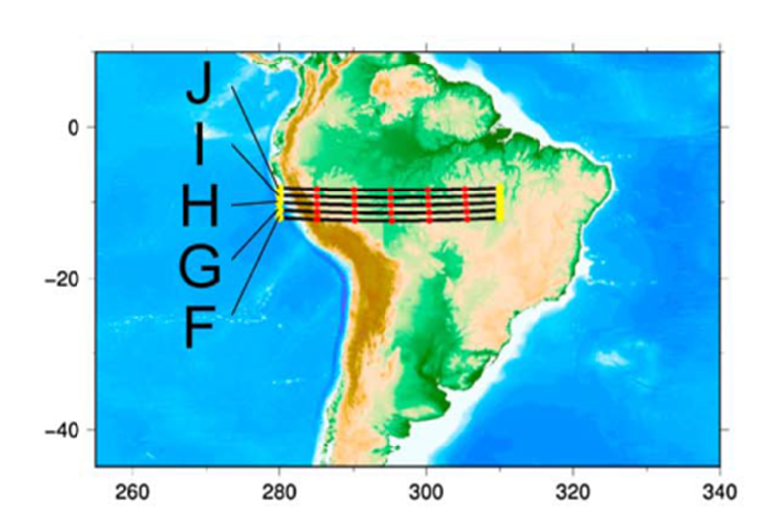
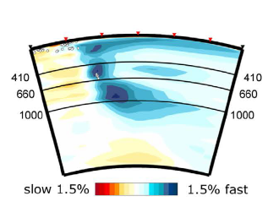
NAZCA SUBDUCTION
Acre, 24.11.2015
earthquake doublet M_{w}~ 7.6
depth ~ 600 km
downdip compression
Fukao and Obayashi, (2013)

Slide 30
NAZCA SUBDUCTION
Acre, 24.11.2015
earthquake doublet M_{w}~ 7.6
depth ~ 600 km
downdip compression
Fukao and Obayashi, (2013)
Stagnation below 660 km boundary

Slide 31
NAZCA SUBDUCTION
Acre, 24.11.2015
earthquake doublet M_{w}~ 7.6
depth ~ 600 km
downdip compression
Fukao and Obayashi, (2013)
Stagnation below 660 km boundary
Geodynamic model of Nazca slab subducting below South America:
Could we obtain vertical compression at the base of the upper mantle?

Slide 32
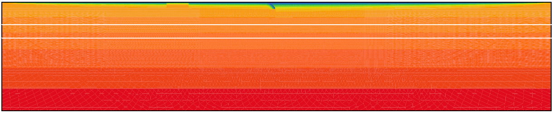

NAZCA SUBDUCTION
Geodynamic model of Nazca slab subducting below South America
ridge
weak crust
ridge
410 km
660 km
2000 km
Nazca South America
(60 Myr old) (130 Myr old)
10000 km
Zahradník et al. (2017)

Slide 33
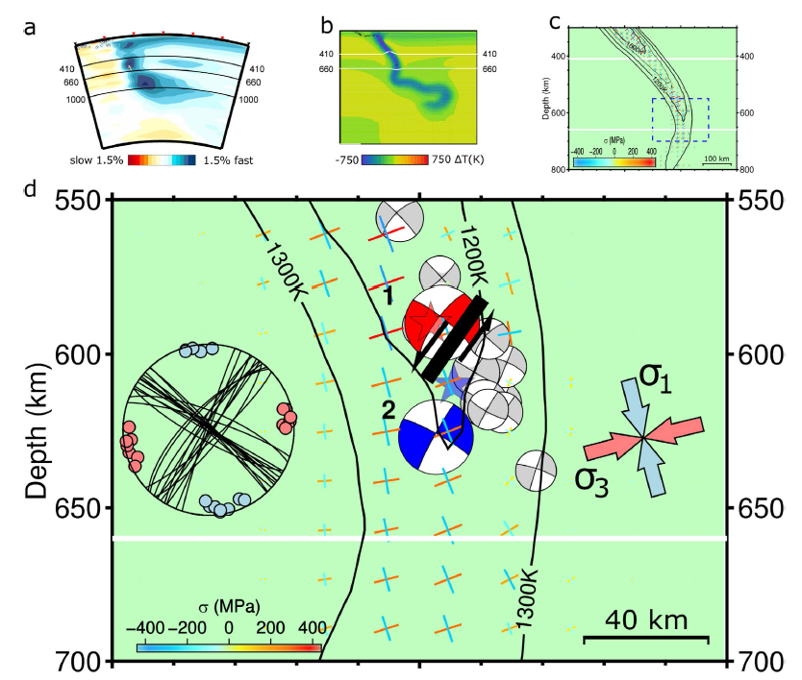
NAZCA SUBDUCTION
Viscosity interface between upper and lower mantle has to be shifted to 1000 km
Zahradník et al. (2017)

Slide 34
SEISMIC-GEODYNAMIC MODELS OF SUBDUCTION
Fukao and Obayashi (2013)
Euro-Asian plate Pacific plate
2000 km
η = η (T,p,σ)
Stress distribution from seismicity
1. generation models that fit locations, stress orientations, …
-1000 0
ΔT (K)

Slide 35
SEISMIC-GEODYNAMIC MODELS OF SUBDUCTION
Fukao and Obayashi (2013)
Euro-Asian plate Pacific plate
2000 km
η = η (T,p,σ)
Stress distribution from seismicity
1. generation models that fit locations, stress orientations, …
Next step – 2. generation models:
explain physical processes that result in intermediate depth earthquakes
-1000 0
ΔT (K)

Slide 36
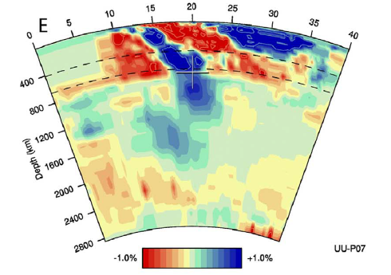
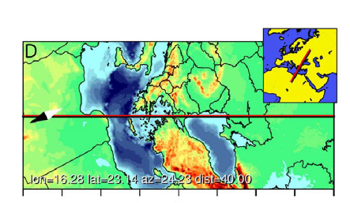
HELLENIC SUBDUCTION
For subduction zone in question (Hellenic arc) we need to
design an initial condition that reflects the situation at this subduction initiation,
perform parametric search for model parameters that result in morphology consistent with observations (tomography, subduction and rollback velocity),
evaluate stresses – they have to agree with seismogenic,
evaluate temperature and pressure conditions, water content
identify seismogenic mechanism (dehydration, metastable phases)
Amaru, 2007; van der Meer et al., 2018

Slide 37
HELLENIC SUBDUCTION
Hellenic subduction setup
Oceanic crust (red) 10 km thick, weak; continental crust (yellow) 30-40 km thick, strong, including heat producing elements
Initial distance between Africa and trench d_{ini}: 0.5 cm/yr, 26-40 Myr
Age of African plate at trench initially 240 Myr, at north Africa coast 200 Myr
d_{ini}
410 km
660 km
2000 km
10000 km ?

Slide 38
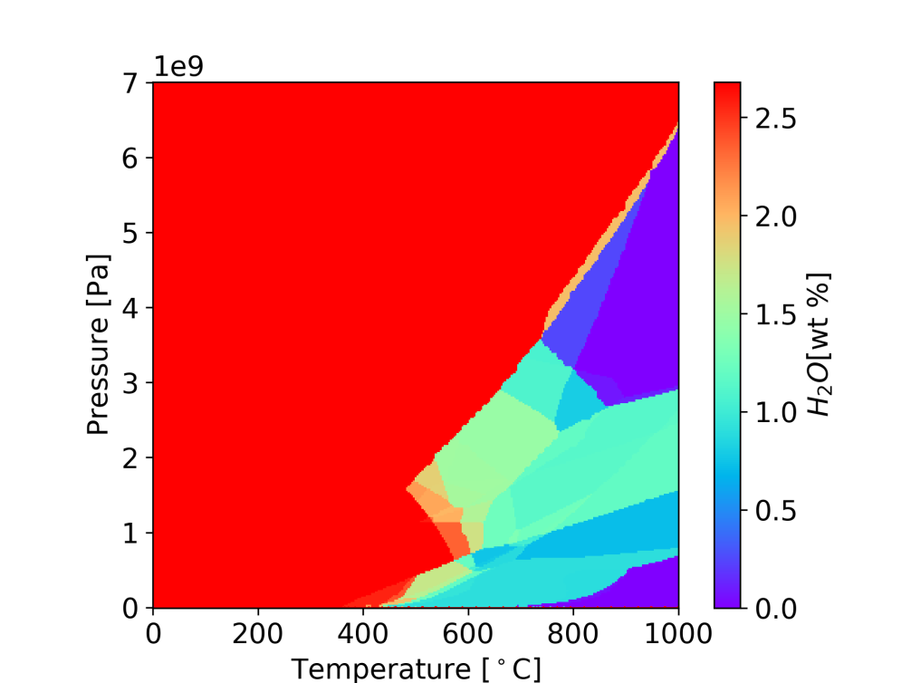
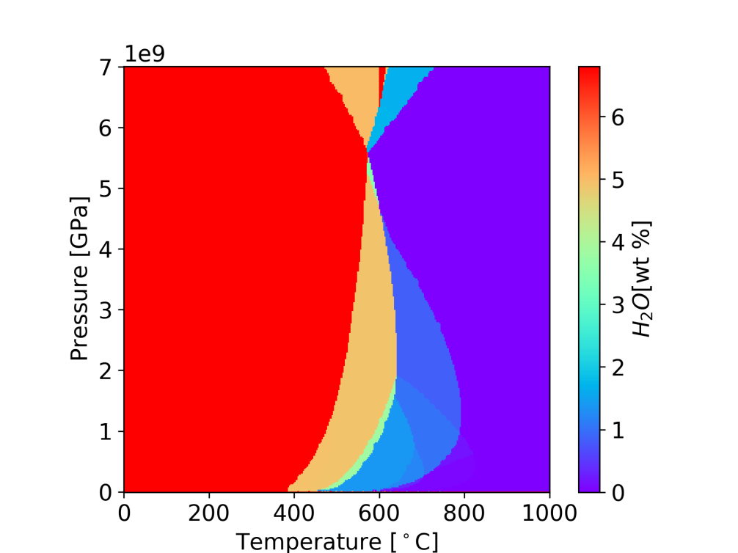
SUBDUCTION MODELS WITH DEHYDRATION
Calculated in Perple_X, based on Chemia et al.,2010
Used in following models
Crust
Mantle
Iwamori

Slide 39
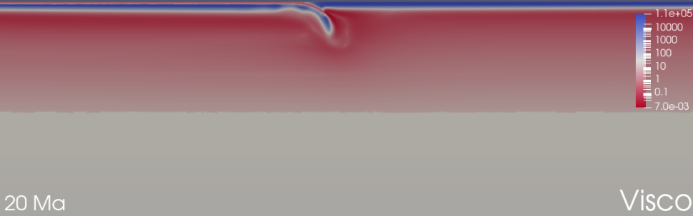
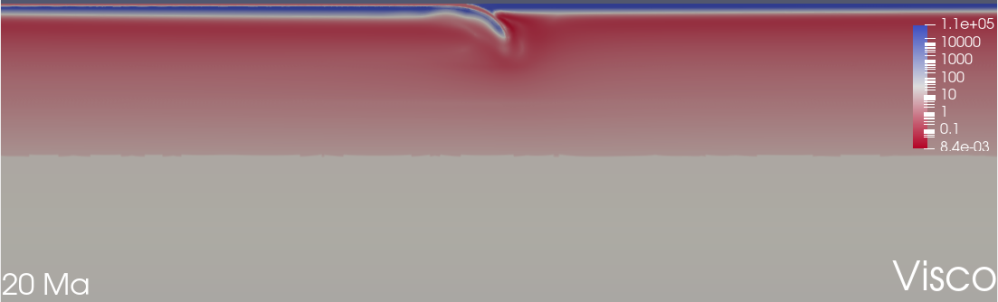
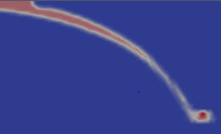
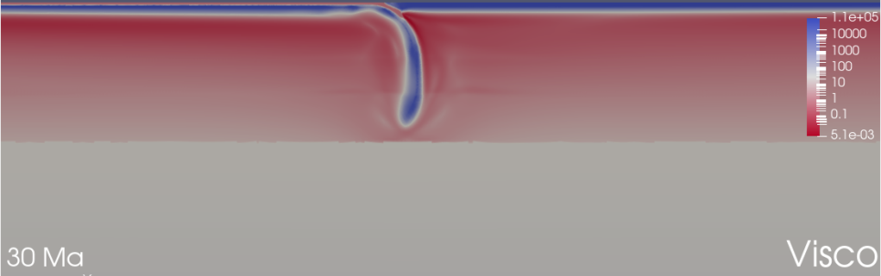
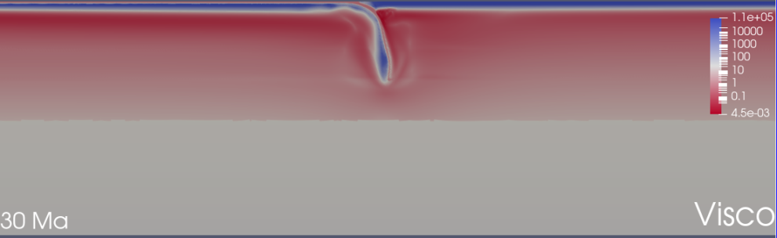
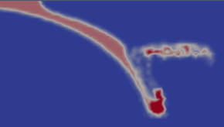
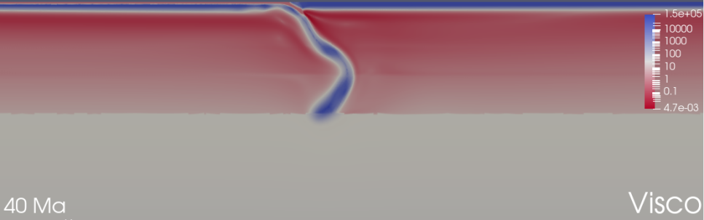
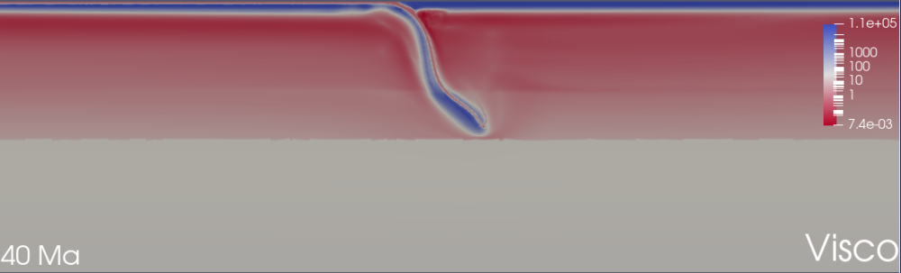
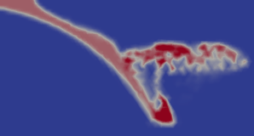
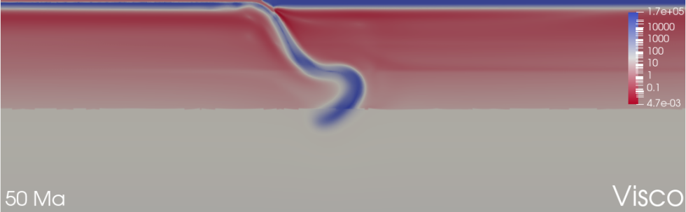
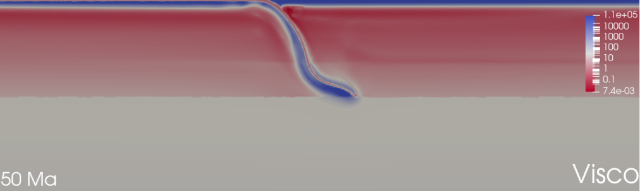

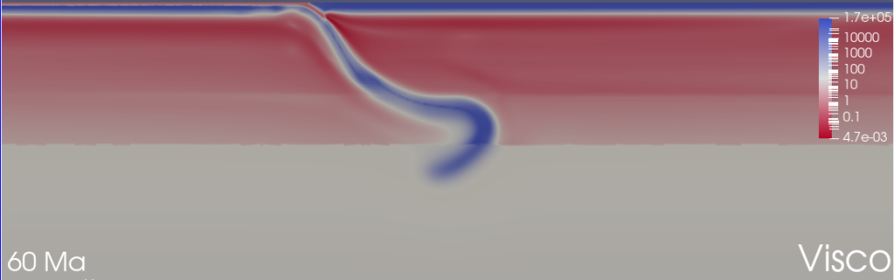
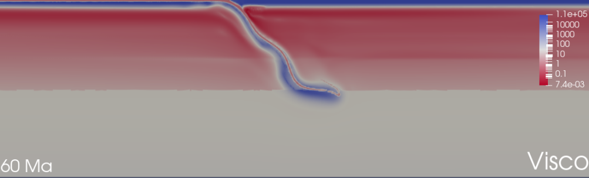

SUBDUCTION MODELS WITH DEHYDRATION
NO water
3% water in crust

Slide 40
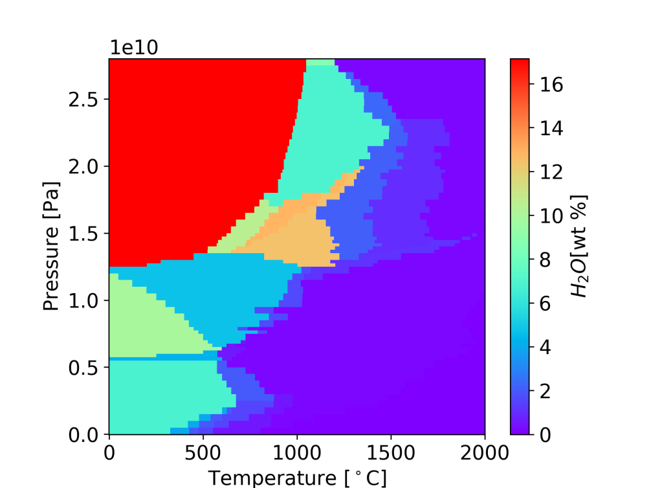
SUBDUCTION MODELS WITH DEHYDRATION
In future calculations we need to use phase diagram
adopted from Iwamori, 2007
Valid to 28 GPa
Crust
Mantle
Chemia et al., 2010 (Perple_X)
Iwamori, 2007

