Slide 1

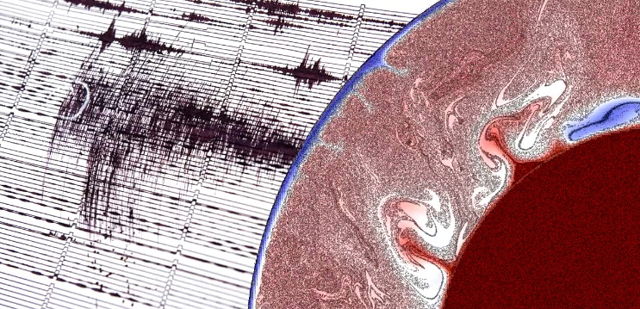
Introduction into Bayesian transdimensional inverse problems
Department of Geophysics
Miroslav Hallo¹
¹ Charles University, Faculty of Mathematics and Physics, Czech Republic; hallo@karel.troja.mff.cuni.cz; http://geo.mff.cuni.cz/~hallo/

Slide 2

Definition of „transdimensional“
Science fiction
Relating to a dimension other than those of the normal 3D world
(Time-traveling, gravity-bending)
Statistics
Having components or subspaces of different dimension
Bayesian inference
If the number of dimension of the model space is itself a variable.
(posterior PDF is a transdimensional function)

Slide 3
Motivation
„With four parameters I can fit an elephant, and with five I can make him wiggle his trunk.“ (John von Neumann)
  By this he meant that one should not be impressed when a complex model fits a data set well. With enough parameters, you can fit any data set.
„Make everything as simple as possible, but not simpler.“ (Einstein)
  He was paraphrasing Occam's Razor (philosopher from 14th sentury). In other words, the best theory (in science or philosophy) is the simplest one that still explains observations.
Is it possible to use the data to decide how to parametrize the model? Parametrize it simple as possible, but not simpler?
  → Transdimensional (trans-D) inversions alow self-adjusted dynamic variations in the model space (trans-D models) driven by data.

Slide 4
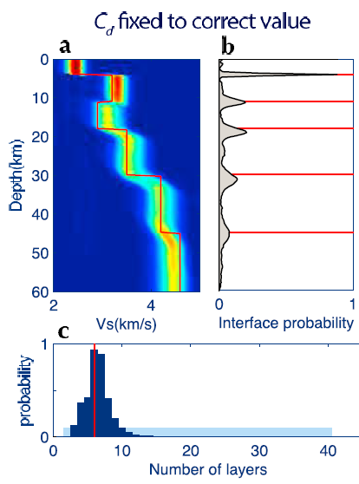
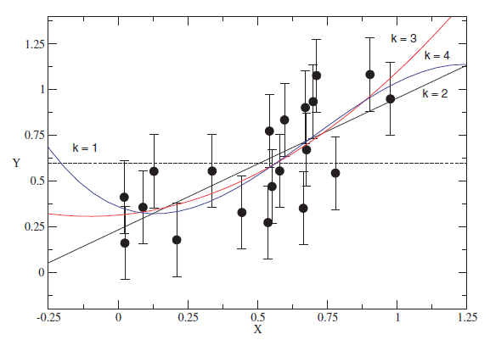
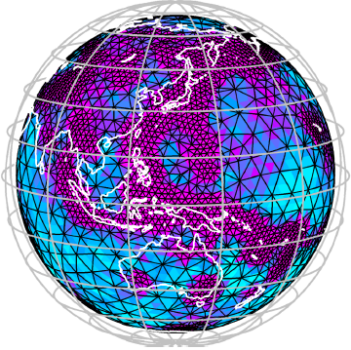
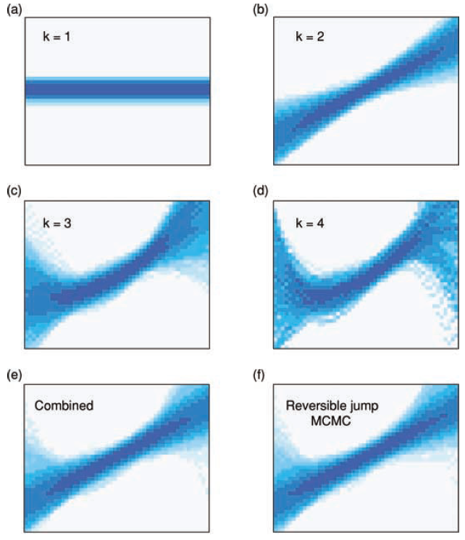
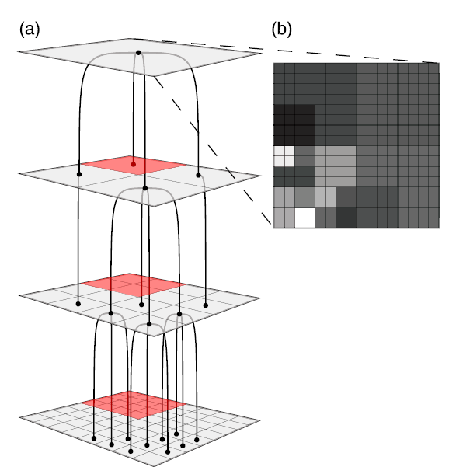
Motivation – possible applications
Receiver
functions
Irregular spatial parametrizations
Polynomial order to fit data

Slide 5
References
Trans-D classic literature
Geyer, C., Moller, J., 1994. Simulation procedures and likelihood inference for spatial point processes, Scandinavian Journal of Statistics, 21 (4), 359–373.
Green, P.J., 1995. Reversible jump Markov chain Monte Carlo computation and Bayesian model determination, Biometrika, 82 (4), 711–732.
Green, P.J., 2003. Trans-dimensional Markov chain Monte Carlo, in Highly Structured Stochastic Systems, pp. 179–198, Oxford Statistical Science Series, Oxford University Press.
Probability of trans-D jump (Use the data to decide how to parametrize the model)
Malinverno, A., 2002. Parsimonious Bayesian Markov chain Monte Carlo inversion in a non linear geophysical problem. Geophysical Journal International, 151, 675–688.
Trans-D in Parallel Tempering
Jasra, A., Stephens, D.A., Holmes, C.C., 2007. Population-based reversible jump Markov chain Monte Carlo, Biometrika, 94 (4), 787–807, doi:10.1093/biomet/asm069.
Sambridge, M., 2014. A Parallel Tempering algorithm for probabilistic sampling and multimodal optimization, Geophysical Journal International, 196, 357-374, doi:10.1093/gji/ggt342.
Trans-D general review
Gallagher, K., Charvin, K., Nielsen, S., Sambridge, M., Stephenson, J., 2009. Markov chain Monte Carlo (McMC) sampling methods to determine optimal models,model resolution and model choice for earth science problems, Marine and Petroleum Geology, 26, 525–535.
Sisson, S., 2005. Transdimensional Markov chains: A decade of progress and future perspectives, Journal of the American Statistical Association, 100 (471), 1077–1090, doi:10.1198/016214505000000664.
Sambridge, M., Gallagher, K., Jackson, A., Rickwood, P., 2006. Transdimensional inverse problems, model comparison and the evidence, Geophysical Journal International, 167, 528–542, doi: 10.1111/j.1365-246X.2006.03155.x.
Trans-D applications
Bodin, T., Sambridge, M., Tkalčić, H., Arroucau, P., Gallagher, K., Rawlinson, N., 2012. Transdimensional inversion of receiver functions and surface wave dispersion, Journal of Geophysical Research, 117, B02301, doi:10.1029/2011JB008560.
Dettmer, J., Dosso, S.E., Holland, C.W., 2010. Trans-dimensional geoacoustic inversion, The Journal of the Acoustical Society of America, 128, 3393–3405, doi:10.1121/1.3500674.
Dettmer, J., Benavente, R., Cummins, P.R., Sambridge, M., 2014. Trans-dimensional finite-fault inversion, Geophysical Journal International, 199, 735–751, doi:10.1093/gji/ggu280.
Dettmer, J., Hawkins, R., Cummins, P.R., Hossen, J., Sambridge, M., Hino, R., Inazu, D., 2016. Tsunami source uncertainty estimation: The 2011 Japan tsunami, J. Geophys. Res. Solid Earth, 121 (6), 4483–4505, doi:10.1002/2015JB012764.

Slide 6
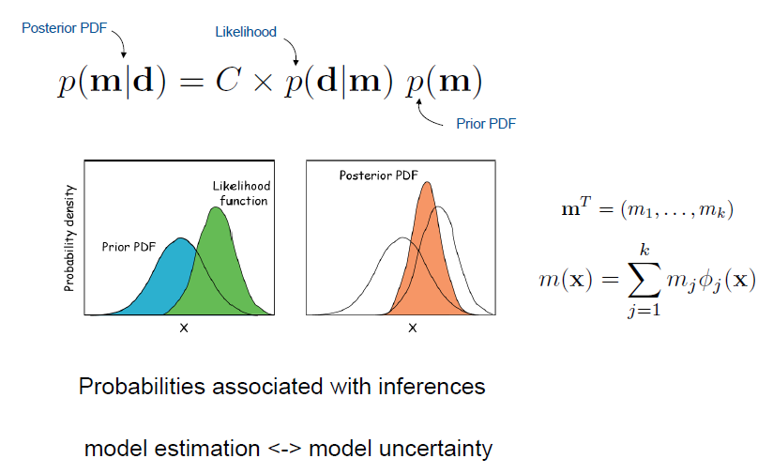
A probabilistic Bayesian framework
Transdimensional inverse problems in the geosciences (presentation by Sambridge M., 26th March 2012, The Royal Society)

Slide 7
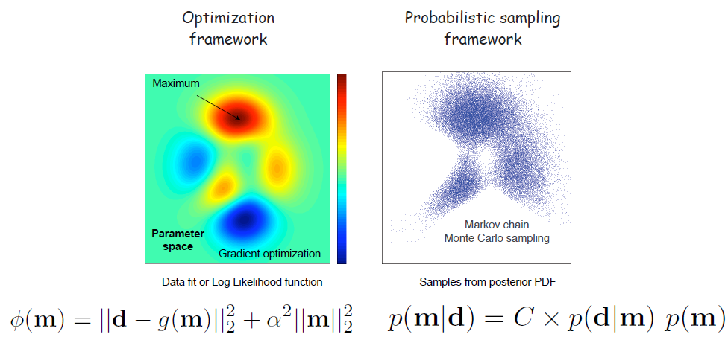
Markov chain Monte Carlo (McMC) sampling of posterior PDF
Transdimensional inverse problems in the geosciences (presentation by Sambridge M., 26th March 2012, The Royal Society)

Slide 8
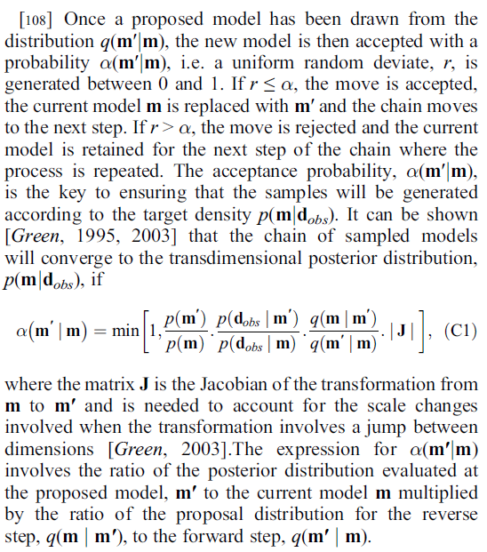
rj-McMC (later trans-D)
Geyer and Moller (1994)
  Metropolis-Hastings algorithm instead „spatial birth-and-death“ in Monte Carlo methods
Green (1995)
  Reversible jump Markov chain Monte Carlo algorithm (rj-McMC)
Green (2003)
  Trans-dimensional Markov chain Monte Carlo
prior likelihood jump
(Bodin et al. 2012)

Slide 9

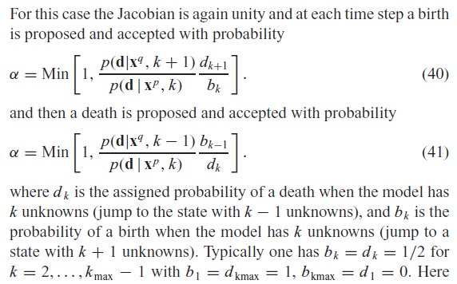
Trand-D exposed
Malinverno (2002)
  - Use the data to decide how to parametrize the model
  - The first complex aplication of rj-McMC
Sambridge et al. (2006)
  - Complete trans-D overview
  - Use the data to decide how to parametrize the model
  - birth-death McMC overview
(Sambridge et al. 2006)

Slide 10
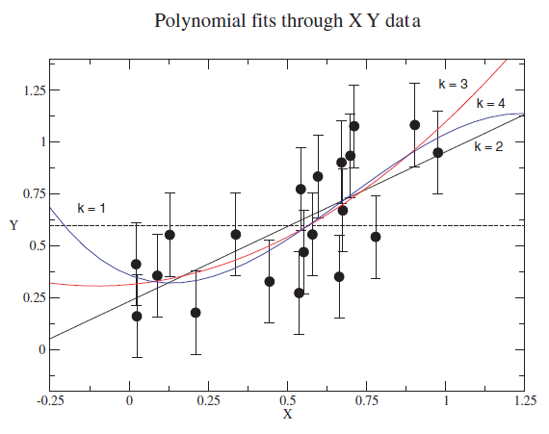
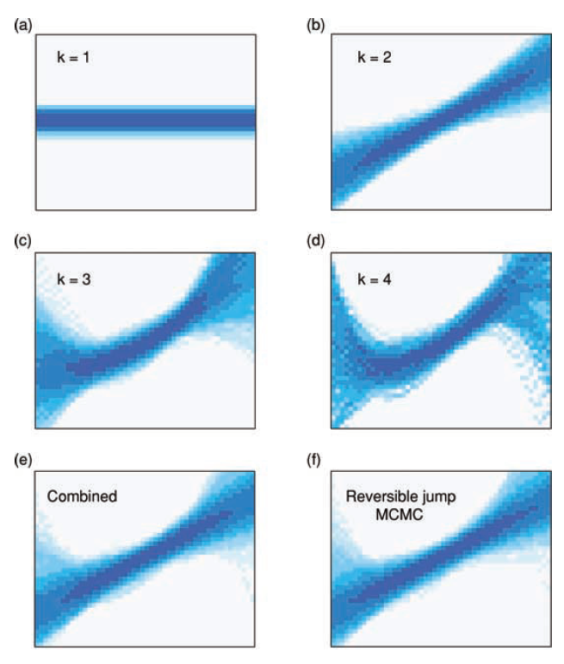
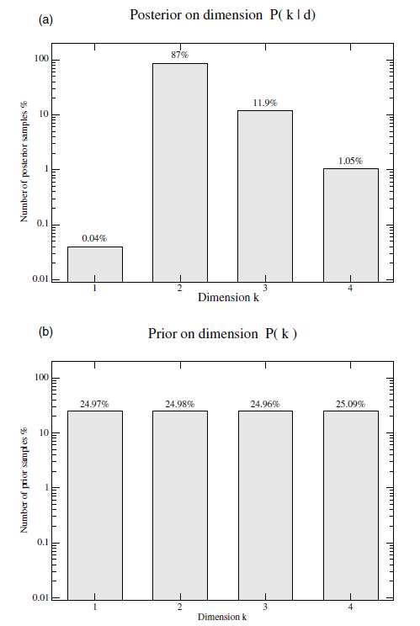
Trand-D exposed - example
(Sambridge et al. 2006)

Slide 11
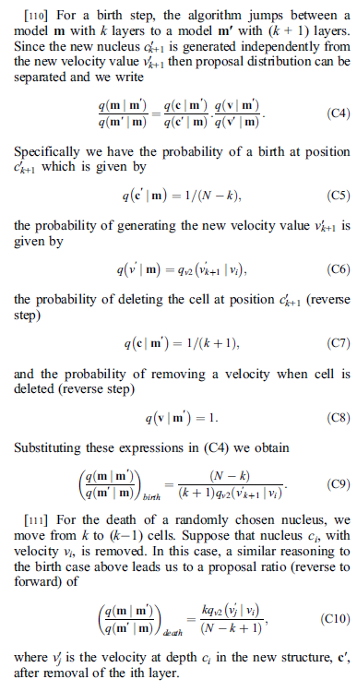
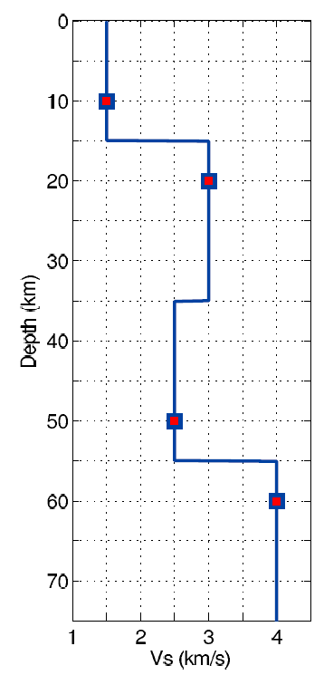
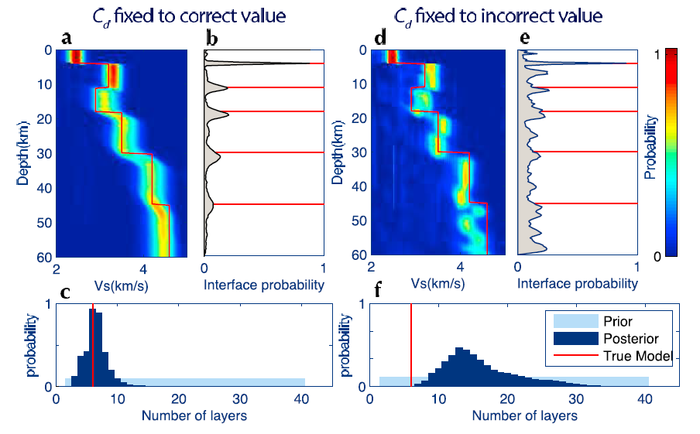
Modern birth-death McMC
Bodin et al. (2012)
  Cleaver parametrization of layers
  Solution depends on choice of cov. matrix
  Detailed Appendix with birth-death McMC
(Bodin et al. 2012)

Slide 12

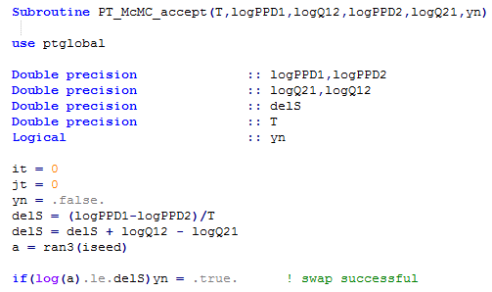
Birth-death McMC by Parallel Tempering
Dettmer et al. (2014)
  Trans-D finite-fault inversion
  An inverse problem with irregular 2D grid
  Only likelihood function is tempered
prior likelihood jump
Parallel Tempering (PT) software library of Fortran 90 routines by Sambridge
http://www.iearth.org.au/codes/ParallelTempering/
Temperature
-log[p(m1|d)]
log[q(m1|m2)]
-log[p(m2|d)]
log[q(m2|m1)]
1. Tempering of the likelihoods’ ratio
2. Add the jump propos. ratio

Slide 13
References
Bodin, T., Sambridge, M., Tkalčić, H., Arroucau, P., Gallagher, K., Rawlinson, N., 2012. Transdimensional inversion of receiver functions and surface wave dispersion, Journal of Geophysical Research, 117, B02301, doi:10.1029/2011JB008560.
Denison, D., Adams, N., Holmes, C., Hand, D., 2002. Bayesian partition modelling, Computational Statistics & Data Analysis, 38 (4), 475–485.
Dettmer, J., Dosso, S.E., Holland, C.W., 2010. Trans-dimensional geoacoustic inversion, The Journal of the Acoustical Society of America, 128, 3393–3405, doi:10.1121/1.3500674.
Dettmer, J., Benavente, R., Cummins, P.R., Sambridge, M., 2014. Trans-dimensional finite-fault inversion, Geophysical Journal International, 199, 735–751, doi:10.1093/gji/ggu280.
Dettmer, J., Hawkins, R., Cummins, P.R., Hossen, J., Sambridge, M., Hino, R., Inazu, D., 2016. Tsunami source uncertainty estimation: The 2011 Japan tsunami, J. Geophys. Res. Solid Earth, 121 (6), 4483–4505, doi:10.1002/2015JB012764.
Gallagher, K., Charvin, K., Nielsen, S., Sambridge, M., Stephenson, J., 2009. Markov chain Monte Carlo (McMC) sampling methods to determine optimal models,model resolution and model choice for earth science problems, Marine and Petroleum Geology, 26, 525–535.
Geyer, C., Moller, J., 1994. Simulation procedures and likelihood inference for spatial point processes, Scandinavian Journal of Statistics, 21 (4), 359–373.
Green, P.J., 1995. Reversible jump Markov chain Monte Carlo computation and Bayesian model determination, Biometrika, 82 (4), 711–732.
Green, P.J., 2003. Trans-dimensional Markov chain Monte Carlo, in Highly Structured Stochastic Systems, pp. 179–198, Oxford Statistical Science Series, Oxford University Press.
Jasra, A., Stephens, D.A., Holmes, C.C., 2007. Population-based reversible jump Markov chain Monte Carlo, Biometrika, 94 (4), 787–807, doi:10.1093/biomet/asm069.
Malinverno, A., 2002. Parsimonious Bayesian Markov chain Monte Carlo inversion in a non linear geophysical problem. Geophysical Journal International, 151, 675–688.
Sambridge, M., Gallagher, K., Jackson, A., Rickwood, P., 2006. Transdimensional inverse problems, model comparison and the evidence, Geophysical Journal International, 167, 528–542, doi: 10.1111/j.1365-246X.2006.03155.x.
Sambridge, M., 2014. A Parallel Tempering algorithm for probabilistic sampling and multimodal optimization, Geophysical Journal International, 196, 357-374, doi:10.1093/gji/ggt342.
Sisson, S., 2005. Transdimensional Markov chains: A decade of progress and future perspectives, Journal of the American Statistical Association, 100 (471), 1077–1090, doi:10.1198/016214505000000664.

